Slide 1
Kai Hwang : Cloud Computing for Machine Learning and Cognitive Applications The MIT Press, June 2017 Chapter 9: TensorFlow, Keras, DeepMind, and Graph Analytics (70 slides for 4-hour lectures) All rights reserved by Kai Hwang and MIT Press, 2017. For exclusive use by qualified instructors adopting the textbook, not for commercial or publication release

Slide 2
DeepMind and Brain Projects at Google in the Past 5 Years
In March 2016, Google AlphaGo program defeated a top Go player. This has opened up the debate between human vs. machine intelligence
Another reported advance is the Google Brain Project. In June 2012, tens of millions of random images from YouTube were recognized by a computer platform built over 16,000 CPU cores at Google
They use a training model over a deep neural network built with 1 billion of artificial neurons. This model system identified basic features of images and succeeded in recognize a cat out of thousands classes of images
The project leader Andrew Ng once said: “We directly put massive data (images) into the artificial system and the system learned (remembered) from the key features of those images, automatically”

Slide 3
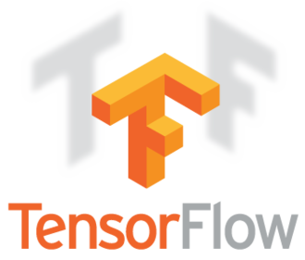
Developer(s) | Google Brain Team^{[1]}
Initial release | November 9, 2015; 21 months ago (2015-11-09)
Stable release | 1.3.0^{[2]} / August 17, 2017; 18 days ago (2017-08-17)
Repository | github.com/tensorflow/tensorflow
Written in | Python, C++, CUDA
Platform | Linux, macOS, Windows, Android
Type | Machine learning library
License | Apache 2.0 open source license
Website | www.tensorflow.org

Slide 4
Creator and Historical Development
TensorFlow is an open-source software library for machine learning across a range of tasks
It is a system for building and training neural networks to detect and decipher patterns and correlations
It is analogous to (but not the same as) human learning and reasoning
TensorFlow was developed by the Google Brain team for internal Google use. It was released under the Apache 2.0 open source license on November 9, 2015

Slide 5
TensorFlow is Google Brain's second generation system. Version 1.0.0 was released on February 11, 2017
While the reference implementation runs on single devices, TensorFlow can run on multiple CPUs and GPUs (with optional CUDA extensions for general-purpose computing on graphics processing units)
TensorFlow is available on 64-bit Linux, macOS, Windows, and mobile computing platforms including Android and iOS
TensorFlow computations are expressed as stateful dataflow graphs. The name TensorFlow derives from the operations that such neural networks perform on multidimensional data arrays. These arrays are referred to as "tensors"
In June 2016, Dean stated that 1,500 repositories on GitHub mentioned TensorFlow, of which only 5 were from Google

Slide 6
Tensor processing unit (TPU)
In May 2016 Google announced its tensor processing unit (TPU), a custom ASIC built specifically for machine learning and tailored for TensorFlow
TPU is a programmable AI accelerator designed to provide high throughput of low-precision arithmetic (e.g., 8-bit), and oriented toward using or running models rather than training them
Google announced they had been running TPUs inside their data centers for more than a year, and have found them to deliver an order of magnitude better-optimized performance per watt for machine learning
In May 2017 Google announced the second-generation, as well as the availability of the TPUs in Google Compute Engine
The second-generation TPUs deliver up to 180 teraflops of performance, and when organized into clusters of 64 TPUs, provide up to 11.5 petaflops

Slide 7
Some Reported TensorFlow Applications
Among the applications for which TensorFlow is the foundation, are automated image captioning software, such as DeepDream, AlphaGo, DeepMind, etc.
RankBrain now handles a substantial number of search queries, replacing and supplementing traditional static algorithm based search results.
Related Fields To TensorFlow Applications
Artificial neural network
Comparison of deep learning software
Convolutional neural network
Deep learning
Machine learning

Slide 8
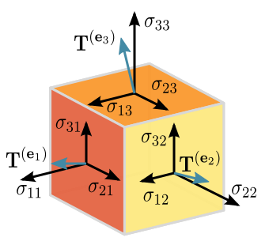
In mathematics, tensors are geometric objects that describe linear relations between geometric vectors, scalars, and other tensors. Elementary examples of such relations include the dot product, the cross product, and linear maps. Geometric vectors, often used in physics and engineering applications, and scalars themselves are also tensors.^{[1]}
Given a reference basis of vectors, a tensor can be represented as an organized multidimensional array of numerical values. The order (also degree or rank) of a tensor is the dimensionality of the array needed to represent it, or equivalently, the number of indices needed to label a component of that array. For example, a linear map is represented by a matrix (a 2-dimensional array) in a basis, and therefore is a 2nd-order tensor. A vector is represented as a 1-dimensional array in a basis, and is a 1st-order tensor. Scalars are single numbers and are thus 0th-order tensors. The collection of tensors on a vector space forms a tensor algebra.

Slide 9
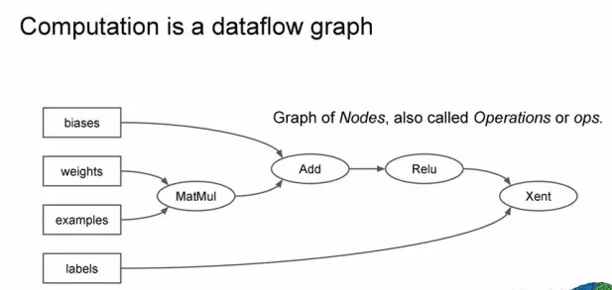
TensorFlow: The Software Framework for Deep Learning Applications

Slide 10
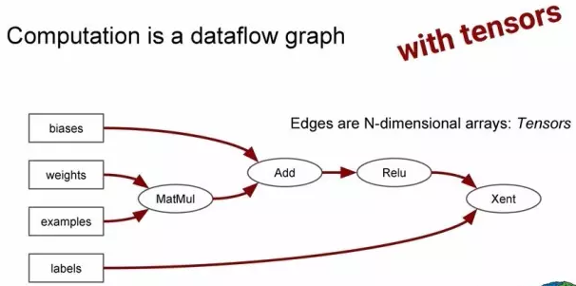
Notes:
使用张量计算

Slide 11
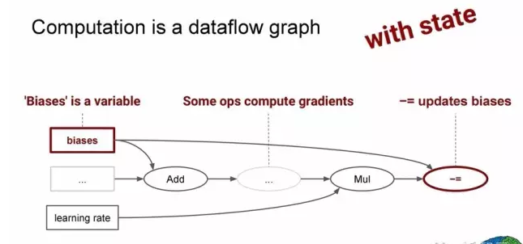
Notes:
使用状态计算

Slide 12
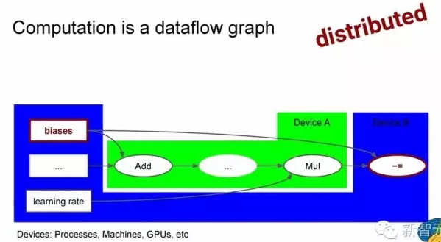
Notes:
使用分布式计算

Slide 13
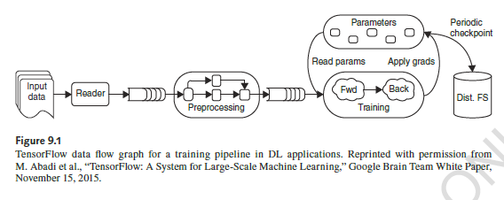

Slide 14
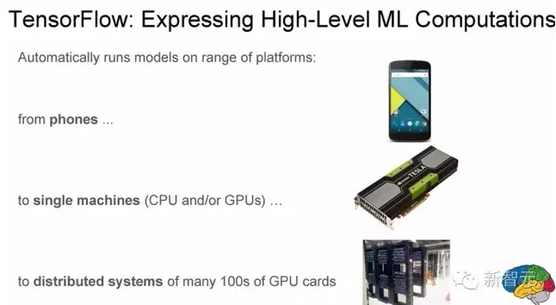

Slide 15
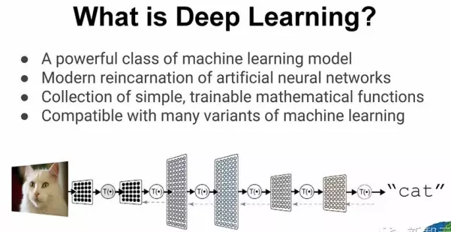
Notes:
深度网络模型与大脑运作原理相似，但并非直接模拟神经元如何工作，而是一种简单抽象的神经元网络。人工神经元不会产生脉冲，只会生成数值。神经元的函数就是通过非线性函数计算输入的加权乘以权重之和。

Slide 16
Tensor Processing Unit (TPU)
Built by Google To Accelerate TensorFlow Execution
16
Notes:
16

Slide 17
Figure 9.5 Synchronous and asynchronous data parallel training methods

Slide 18
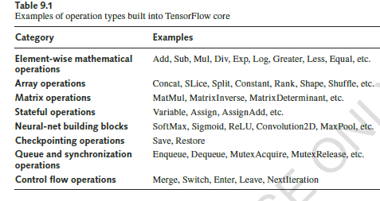

Slide 19
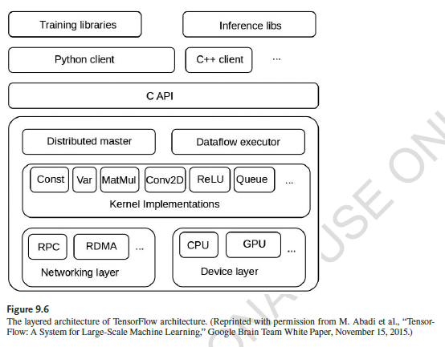

Slide 20
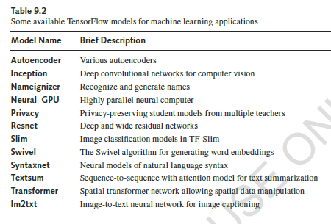

Slide 21
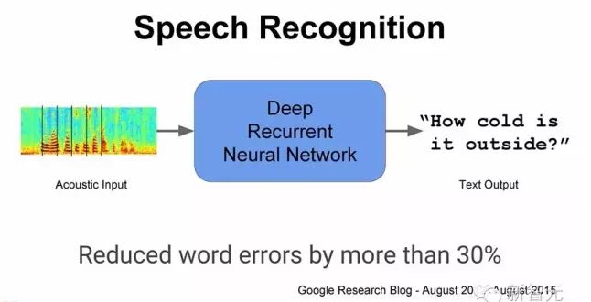
Notes:
语音识别

Slide 22
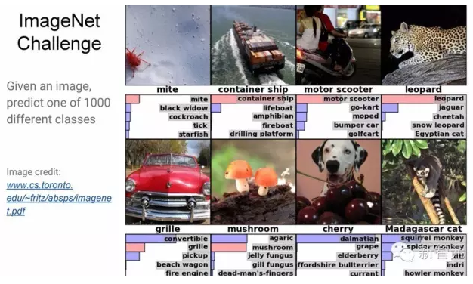

Slide 23
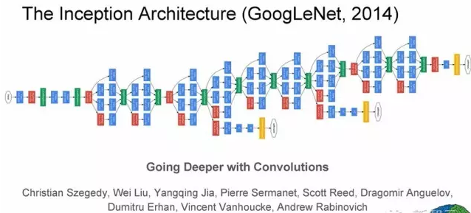

Slide 24
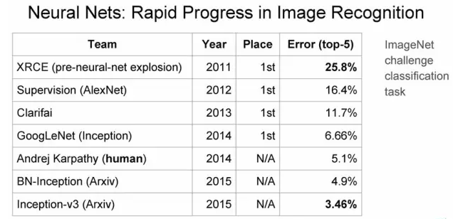

Slide 25
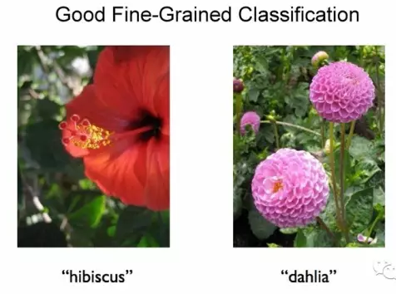

Slide 26
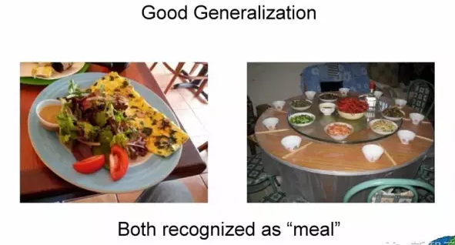

Slide 27
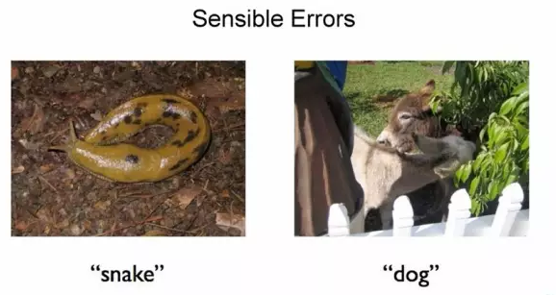

Slide 28
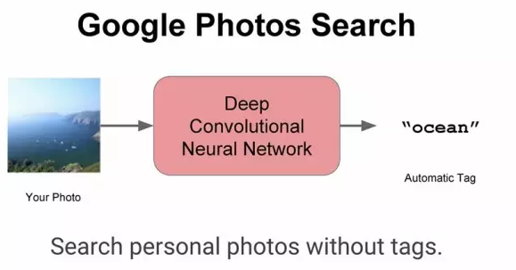

Slide 29
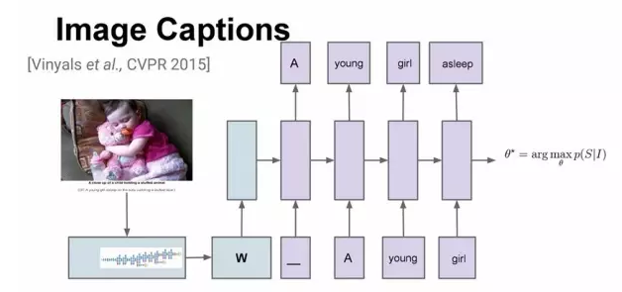

Slide 30
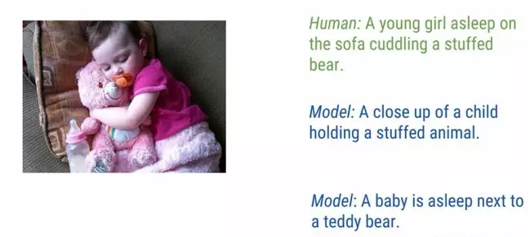
Notes:
描述图像

Slide 31
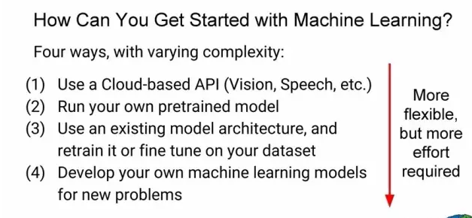
Notes:
TensorFlow 应用举例

Slide 32
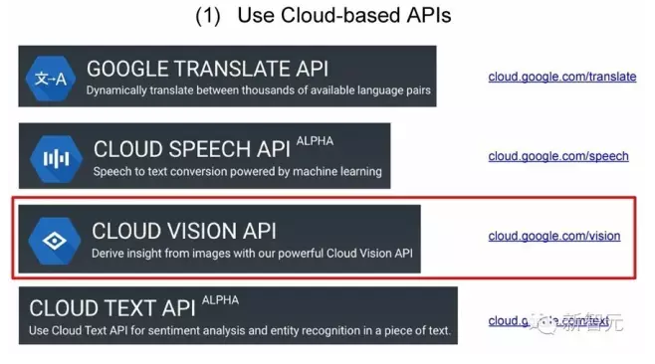
Notes:
使用云端API

Slide 33
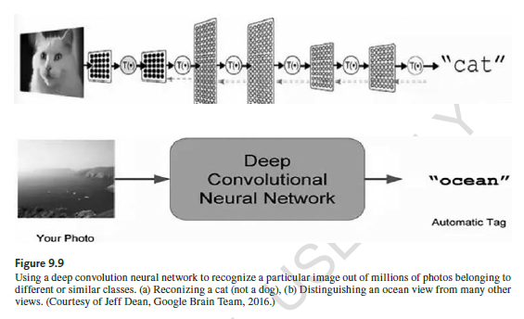

Slide 34
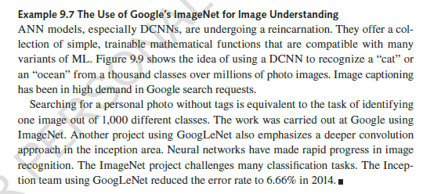

Slide 35
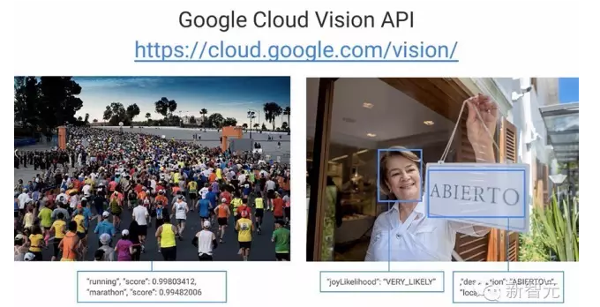
Notes:
（1）使用云端API

Slide 36
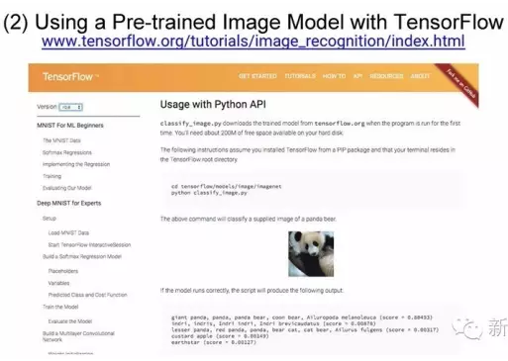
Notes:
使用Pre-trained图像模型

Slide 37
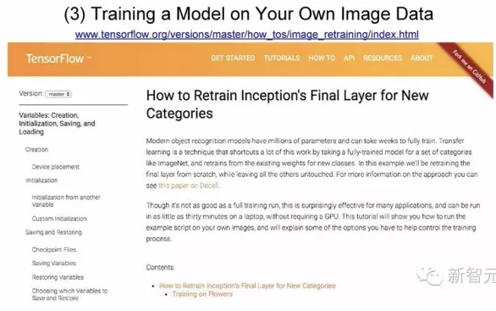
Notes:
用你自己的图像数据训练模型

Slide 38
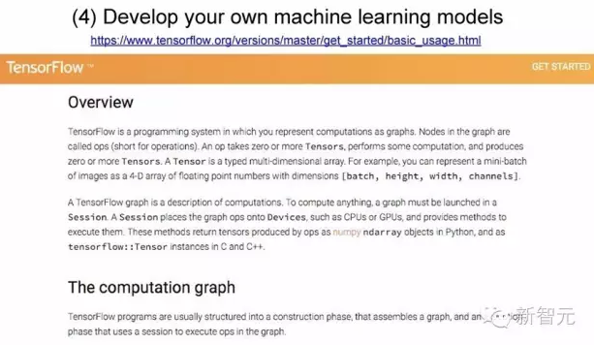
Notes:
开发你自己的机器学习模型

Slide 39
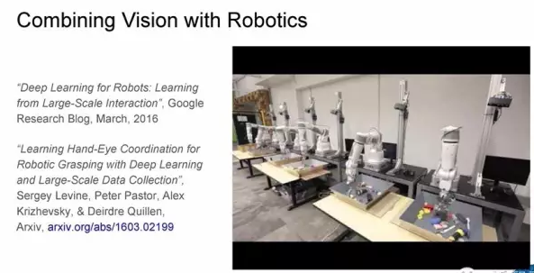
Notes:
与机器人视觉结合

Slide 40
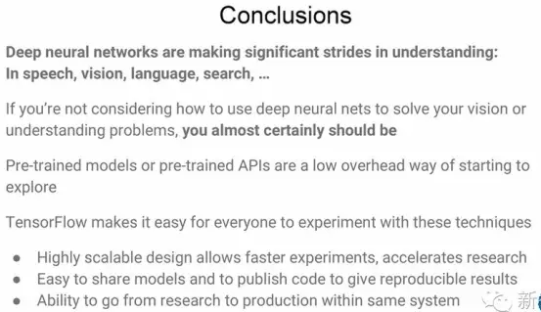
Notes:
总结
深度学习在语音、视觉、语言和语义等方面为计算机实现理解做出极大贡献
如果不考虑使用深度学习，很有可能是你的pre-trained模型或API太旧
TensorFlow的好处
高度扩展的设计，更快的实验速度加速研究进程
容易分享模型，开发代码应用到可重用的效果
通过同一个系统把研究工作直接用于生产环境

Slide 41
Notes:
总结
深度学习在语音、视觉、语言和语义等方面为计算机实现理解做出极大贡献
如果不考虑使用深度学习，很有可能是你的pre-trained模型或API太旧
TensorFlow的好处
高度扩展的设计，更快的实验速度加速研究进程
容易分享模型，开发代码应用到可重用的效果
通过同一个系统把研究工作直接用于生产环境

Slide 42
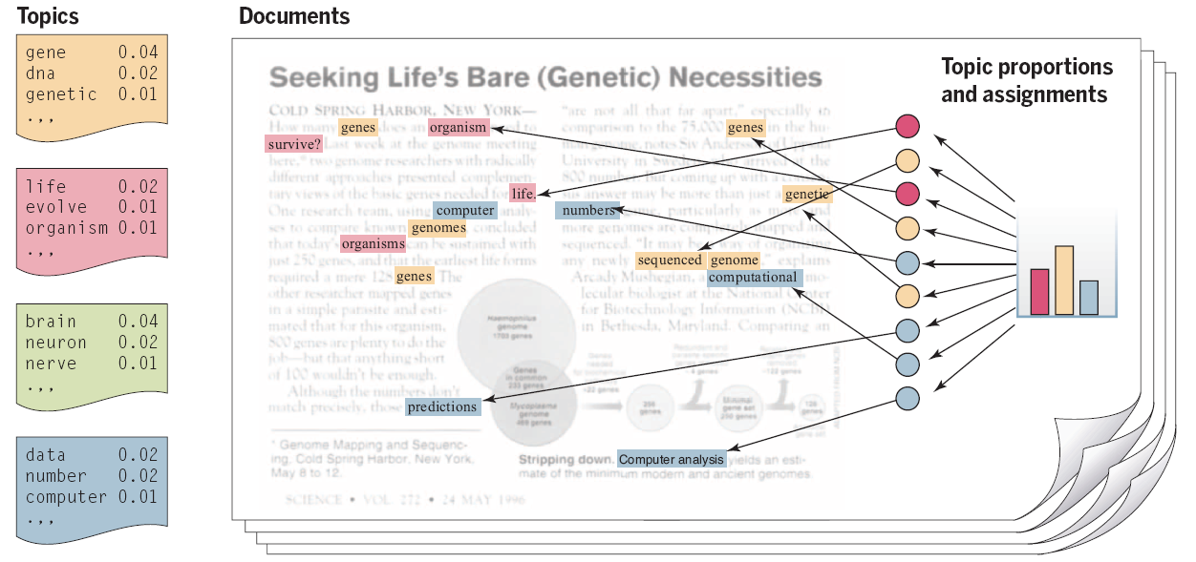
Topic Model for Analyzing Documents
Topic modeling is a methodology for analyzing documents, where a document is viewed as a collection of words, and the words are viewed as being generated by an underlying set of topics (denoted by the colors). Topics are probability distributions across words (leftmost column), and each document is characterized by a probability distribution across topics (histogram).

Slide 43
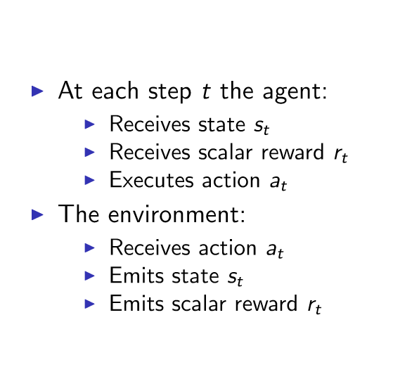
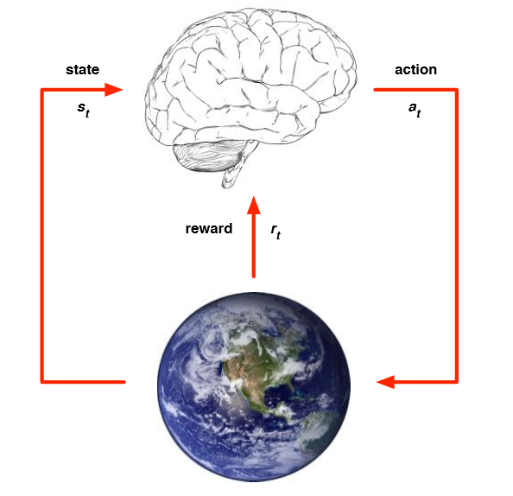
The Concept of Reinforcement Learning

Slide 44
DeepMind AlphaGo Program
AlphaGo program defeated the world Go Champaign in March 2016. The Go is the most complicated chase-board game played on a 19×19 grid by two players placing black and white stones on the board alternatively
There are 361 board points that can be placed. The whole game may end up with 10¹⁷⁰ possible choices for the player to consider
The AlphaGo AI program was developed by DeepMind, an AI subsidiary under the Alphabet Company. This milestone achievement marked the era that machine intelligence can beat human players in some selected areas
Notes:
44

Slide 45
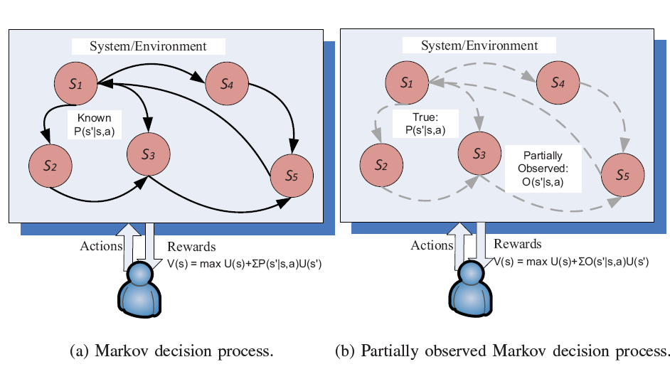
Reinforcement Learning

Slide 46
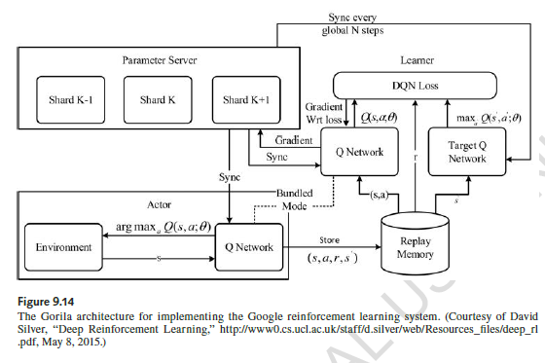

Slide 47
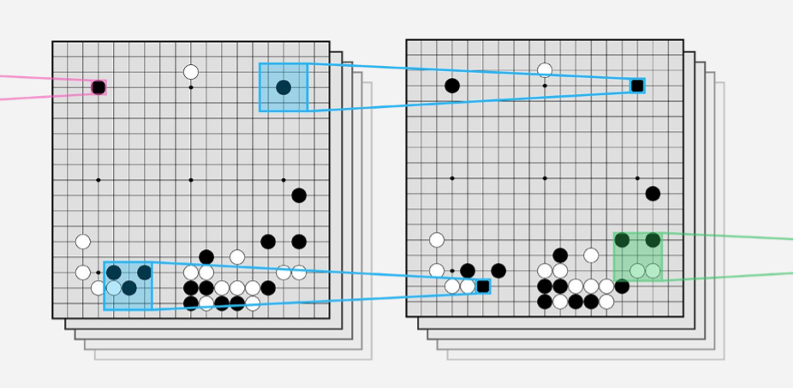
Figure 9.13: Convolutional neural network for processing the Go playing board

Slide 48
DeepMind and Brain Projects at Google
In 2016, Google AlphaGo program defeated the top Go player. This opened up the debate between human intelligence vs. machine intelligence
The Google Brain Team has used large CPU/GPU/TPU clusters to recognize 2000 classes of photo images trained from billions of YouTube images

Slide 49
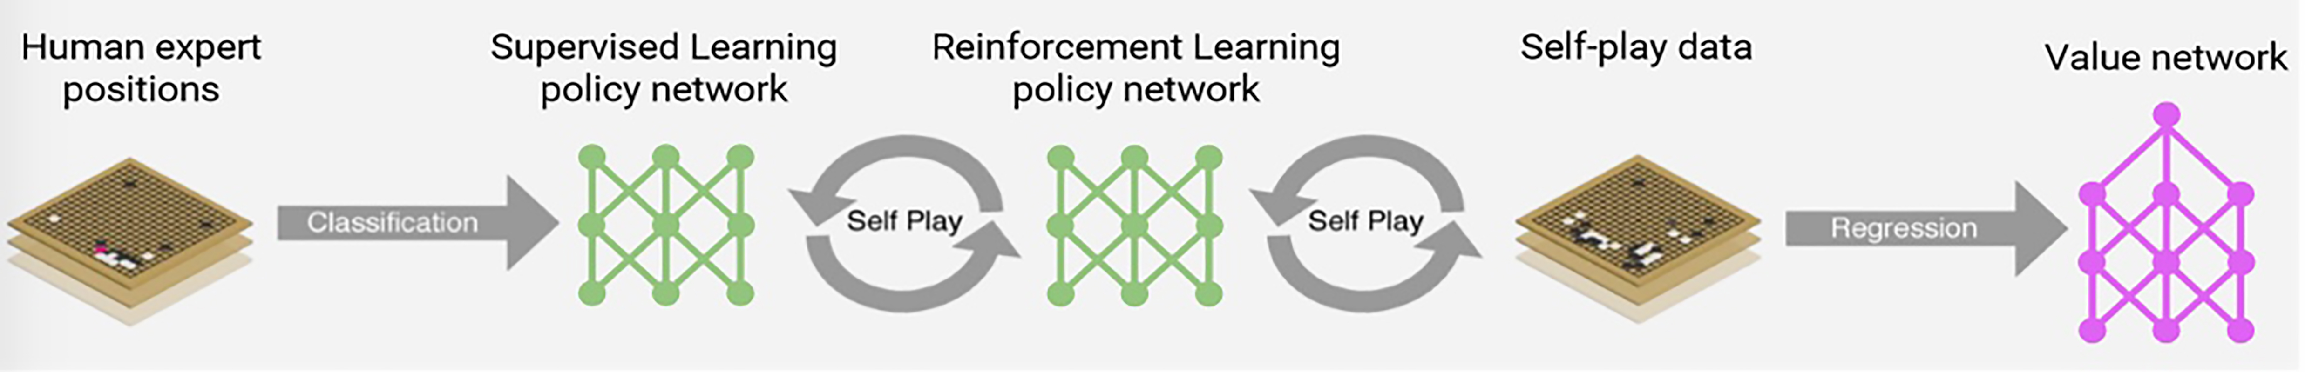
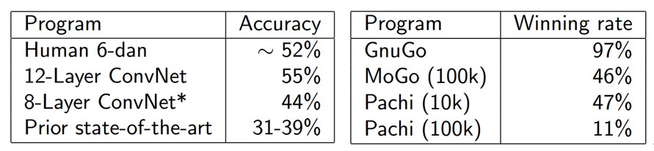
Figure 9.15 The self-play training pipeline between policy network and value networks by human experts
Figure 9.17 Performance of different AlphaGo programs

Slide 50
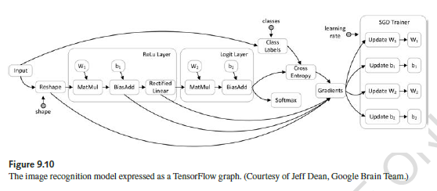

Slide 51
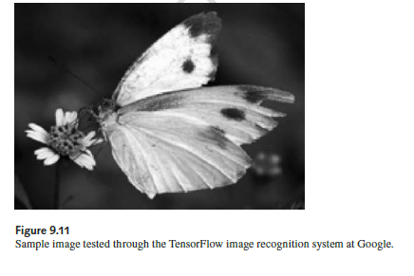

Slide 52
Predictive Analytics Methods
Linear Regression
Logistic Regression
Decision Trees
Artificial Neural Networks (ANN)
Support Vector Machines (SVM)
Multiclass Classification

Slide 53
Example Analytics Applications
Credit Risk Modeling
Fraud Detection
Net Lift Response Modeling
Churn Prediction
Recommender Systems
Web Analytics
Social Media Analytics
Business Process Analytics

Slide 54
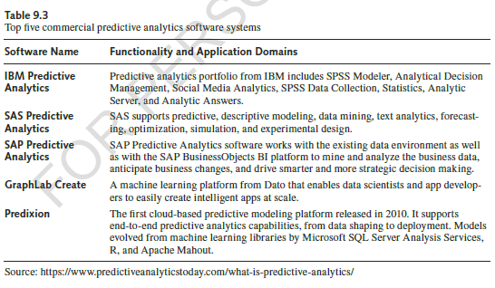

Slide 55
Keras : A High-Level Deep Learning Library
Keras is a high-level neural networks library, written in Python. The system is capable of running on top of either TensorFlow or Theano. The Keras developer focuses on enabling fast experimentation in deep learning with various types of deep neural networks. The library allows for easy and fast prototyping through total modularity, minimalism, and extensibility. Specifically, it supports both convolutional networks and recurrent networks, as well as combinations of the two most important neural networks. Arbitrary connectivity schemes are supported, including multi-input and multi-output training. The system runs seamlessly on CPU and GPU. Listed below are guiding principles in using the Keras library.
Modularity: A model is understood as a sequence or a graph of standalone, fully-configurable modules that can be plugged together with as little restrictions as possible. In particular, neural layers, cost functions, optimizers, initialization schemes, activation functions, regularization schemes are all standalone modules that you can combine to create new models.
Minimalism: Each module should be kept short and simple. Every piece of code should be transparent upon first reading. No black magic: it hurts iteration speed and ability to innovate.
Easy extensibility: New modules are dead simple to add (as new classes and functions), and existing modules provide ample examples. To be able to easily create new modules allows for total expressiveness, making Keras suitable for advanced research.
Work with Python: No separate models configuration files in a declarative format. Models are described in Python code, which is compact, easier to debug, and allows for ease of extensibility.

Slide 56
DIGITS 5 for Segmentation Workflowin GPU-based Deep Learning
In 2016, Nvidia announced a new software platform, known as Nvidia DIGITS 5. This platform supports the training of neural networks in GPU-based deep learning applications. This software platform has been designed with the following two important functions for neural network computing. In many ways, this software package completes the TensorFlow approach in promoting distributed parallel execution on multiple GPU devices. This is a completely integrated system for segmentation workflow in neural network applications. The system creates a database for photo image segmentation that enables the visualization of the output image from a segmented neural network.
DIGITS model store is an open-source online knowledge base. It can download network description and pre-training models. We explore below the object of image segmentation. We introduce the steps to use DIGITS 5 to train a neural network to understand and setting up the SYNTHIA database to synthesize the cars, pedestrians, road signs, and any other objects on city streets. This feature is critically important to accelerate deep learning in guiding self-driving cars that read and understand images taken from the on-board cameras. Nvidia has been a pioneer in accelerating deep learning with GPU hardware supported by deep learning software tools for a number of years. The following example explain the concept. More details can be found in Nvidia website.

Slide 57
Example 9.7: Instance-Aware Image Segmentation in Neural Network Learning Operations
The instance-aware image segmentation (IAIS) refers to the segmentation of a given image into multiple segments or component parts. The neural network can learn the boundary of skeleton of each subdivided image segments. This very useful in practical imaging understanding applications. As shown in Fig.9.17, the IAIS system must be able to understand each class of image segments, even under the condition that some segment boundaries are fuzzy and not clearly distinguishable from surrounding image segments.
The left image has 5 persons lined up in a photo shot. The middle image is the segmented images of the five persons that are attached to each other without clear boundaries among them. The rightmost image is the same image after the IAIS treatment . Now their skeleton boundaries are plotted with edge extraction and labeling by different colors for different persons. The color labeling is one way to distinguish the individuals. This is the main concept of instance segmentation. The Facebook SharkMask has applied this technique to do image understanding and captioning.

Slide 58
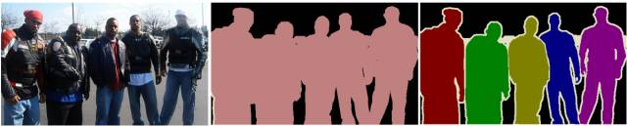
Figure 9.18: A 5-person photo taken from the PASCAL VOC database. The segmented image is at the middle. The instance-segmented image is shown at the right for identification purpose. (Courtesy of www.nvidia.com, 2016).
Today's deep learning solutions rely almost exclusively on NVIDIA GPU-accelerated computing to train and speed up challenging applications such as image, handwriting, and voice identification. A deep learning system with Nvidia GPUs encourages parallel execution of image workloads. This can speed up networks by 10 to 75 times faster than using traditional CPUs. This has reduced the time of many image data training iterations from several weeks to just days. Nvidia has claimed that GPUs can achieve a 12 times in training deep neural networks (DNNs) over the use of CPU devices.
In general, the GPU approach offers faster AI application development. As a matter fact, today’s computers can perform not only learning operations, but also some kind of thinking in the image recognition process. This opens up the opportunities in applications on robots, medicine, and self-driving cars. You can quickly design and deploy deep learning applications with real time responses. The GPUs are largely used in desktops, notebooks, servers and supercomputers around the world. Noe even GPU clouds have appeared in Amazon, IBM and Microsoft cloud platforms. The following example show a complete training solution in playing multiparty game.

Slide 59
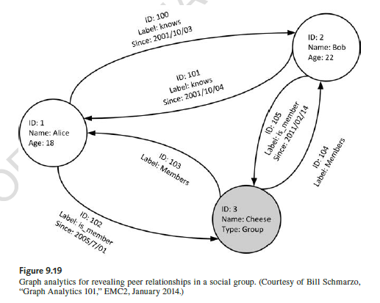

Slide 60
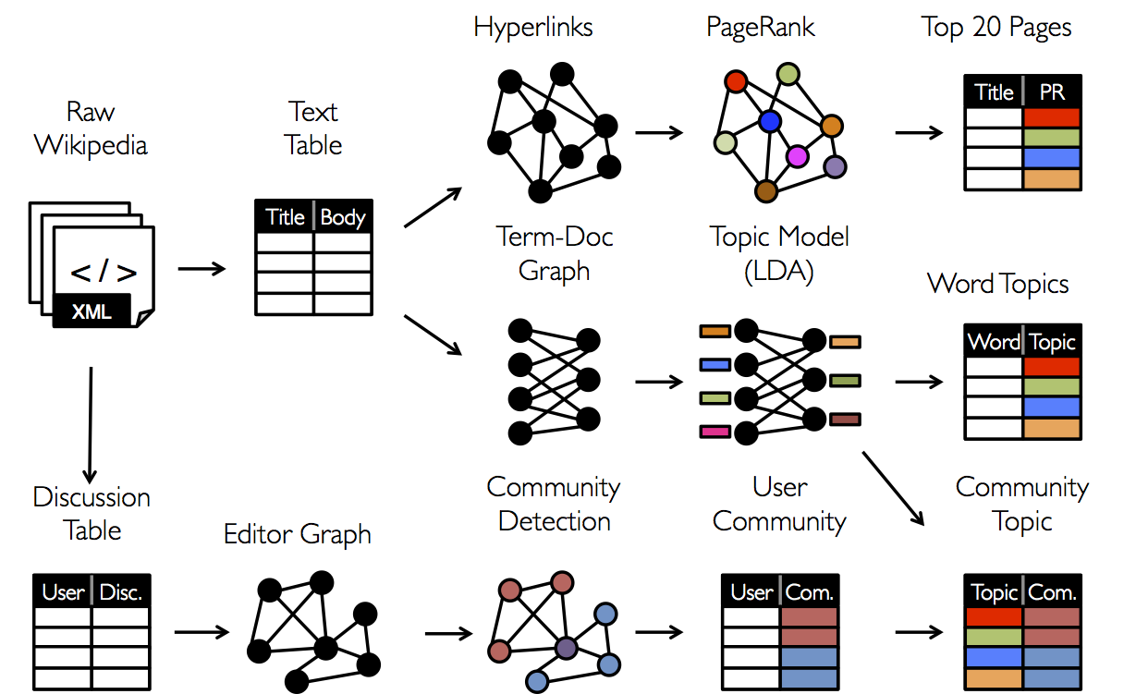
Figure 9.20: Converting raw data to tables and graphs berfore they are analyzed by graph algorithms. (Courtesy of Apache, https://www.spark.apache.org/ docs/0.9.0/graphx-programming-guide, 2016 [2])

Slide 61
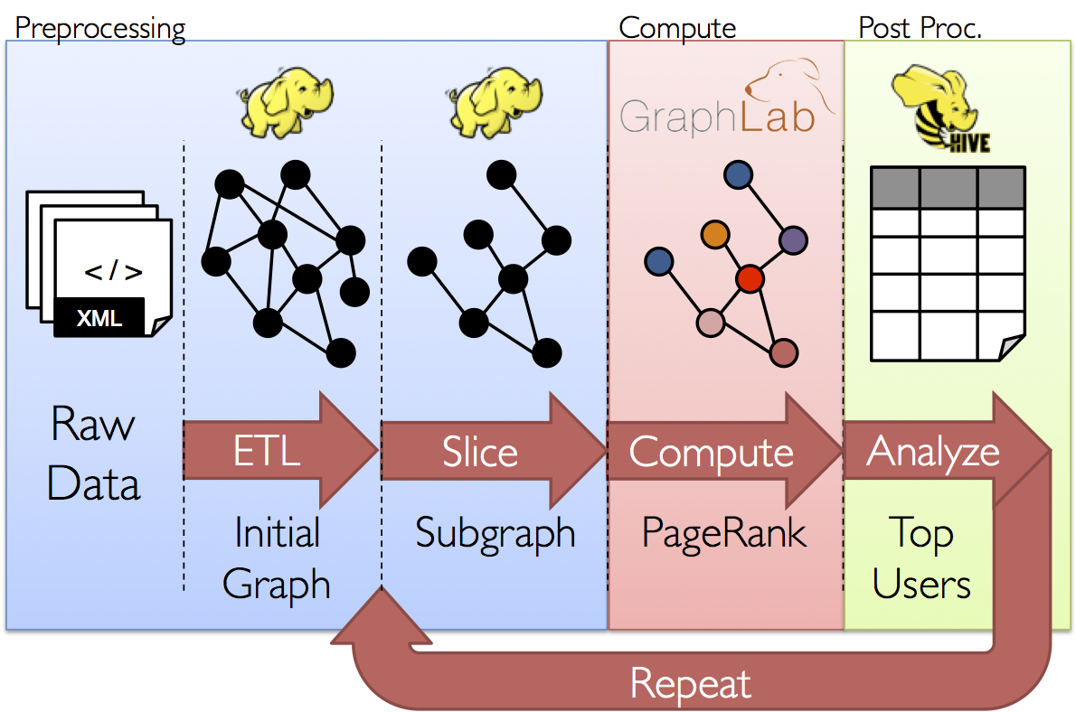
Figure 9.21: A typical graph analytics pipeline consisting of 5 functional stages. (Courtesy of Apache Spark, https://www.spark.apache.org/ docs/0.9.0/graphx-programming-guide, 2016)

Slide 62
Figure 9.23 High scholl community formation based on grade class membership (Courtesy of Xie, J. et al, “Overlapping community detection in networks”, ACM Computing Survey, August 2013 [15])

Slide 64
Operations and Kernels
An operation has a name and represents an abstract computation (e.g., “matrix multiply”, or “add”). An operation can have attributes, and all attributes must be provided or inferred at graph-construction time in order to instantiate a node to perform the operation. One common use of attributes is to make operations polymorphic over different tensor element types (e.g., add of two tensors of type float versus add of two tensors of type int32). Google provides special cloud-based APIs for translate, speech, vision and text applications.
A kernel is a particular implementation of an operation that can be run on a particular type of device (e.g., CPU or GPU). A TensorFlow binary defines the sets of operations and kernels available via a registration mechanism. This set can be extended by linking in additional operation and/or kernel definitions/registrations. Table 9.1 shows operations types built into the core of TensorFlow library:

Slide 65
Tensors:
A tensor in our implementation is a typed, multidimensional array. We support a variety of tensor element types, including signed and unsigned integers ranging in size from 8 bits to 64 bits, IEEE float and double types, a complex number type, and a string type (an arbitrary byte array). Backing store of the appropriate size is managed by an allocator that is specific to the device on which the tensor resides. Tensor backing store buffers are reference counted and are deallocated when no references remain.
Sessions:
Clients’ programs interact with the TensorFlow system by creating a Session. To create a computation graph, the Session interface supports an Extend method to augment the current graph managed by the session with additional nodes and edges. Assume the initial graph when a session is created is empty. The other primary operation supported by the session interface is Run, which takes a set of output names that need to be computed, as well as an optional set of tensors to be fed into the graph in place of certain outputs of nodes.

Slide 66
import tensorflow as tf
b = tf.Variable(tf.zeros([100])) // 100-d vector, initialize to zeroes
W = tf.Variable(tf.random_uniform([784,100],-1,1)) // 784x100 matrix w/rnd vals
x = tf.placeholder(name="x") // Placeholder for input
relu = tf.nn.relu(tf.matmul(W, x) + b) // Relu(Wx+b)
C = [...] // Cost computed as a function of relu
s = tf.Session()
for step in xrange(0, 10):
input = ...construct 100-D input array ... // Create 100-d vector for input
result = s.run(C, feed_dict={x: input}) // Fetch cost, feeding x=input
print step, result

Slide 67
To Create a TensorFlow Cluster: A TensorFlow "cluster" is a set of "tasks" that participate in the distributed execution of a TensorFlow graph. Each task is associated with a TensorFlow "server", which contains a "master" that can be used to create sessions, and a "worker" that executes operations in the graph. A cluster can also be divided into one or more "jobs", where each job contains one or more tasks. To create a cluster, you start one TensorFlow server per task in the cluster. Each task typically runs on a different machine, but you can run multiple tasks on the same machine (e.g. to control different GPU devices). The following actions are taking place in a clutster.
Create a tf.train.ClusterSpec that describes all of the tasks in the cluster. This should be the same for each task.
Create a tf.train.Server, passing the tf.train.ClusterSpec to the constructor, and identifying the local task with a job name and task index.
Create a tf.train.Server instance in each task. This instance contains local devices, connections to other tasks in its tf.train.ClusterSpec, and a session target to perform the distributed computation. Each server is a member of a specific job and has a task index within that job. All servers can communicate with each other in the cluster.

Slide 68
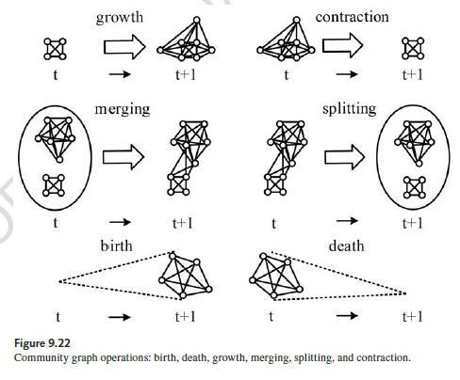

Slide 69
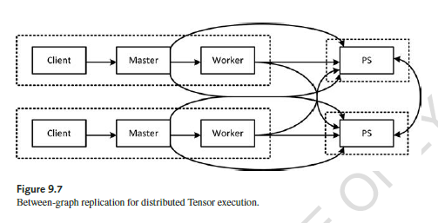
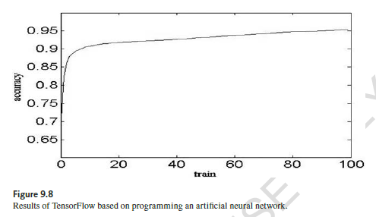

Slide 70
Final Remarks
Deep Learning is now supported by both hardware chips, and devices, plus software platforms for both cloud and edge computing applications
We must use clouds and big-data analytics in storing, processing, and mining of big data, which changes rapidly in time and space
Machine intelligence , clouds, IoT and social networks are being integrated together to promote global economy, public healthcare, smart cities and environments

